Slide 1
Lecture 2 Pre-processing serological data
May 21, 2025
Seroanalytics Training Blantyre, Malawi

Slide 2
Lecture Outline:
Why is pre-processing important?
When is pre-processing sufficient?
Background correction
Transformation
Normalization

Slide 3
Why is pre-processing important?

Slide 4
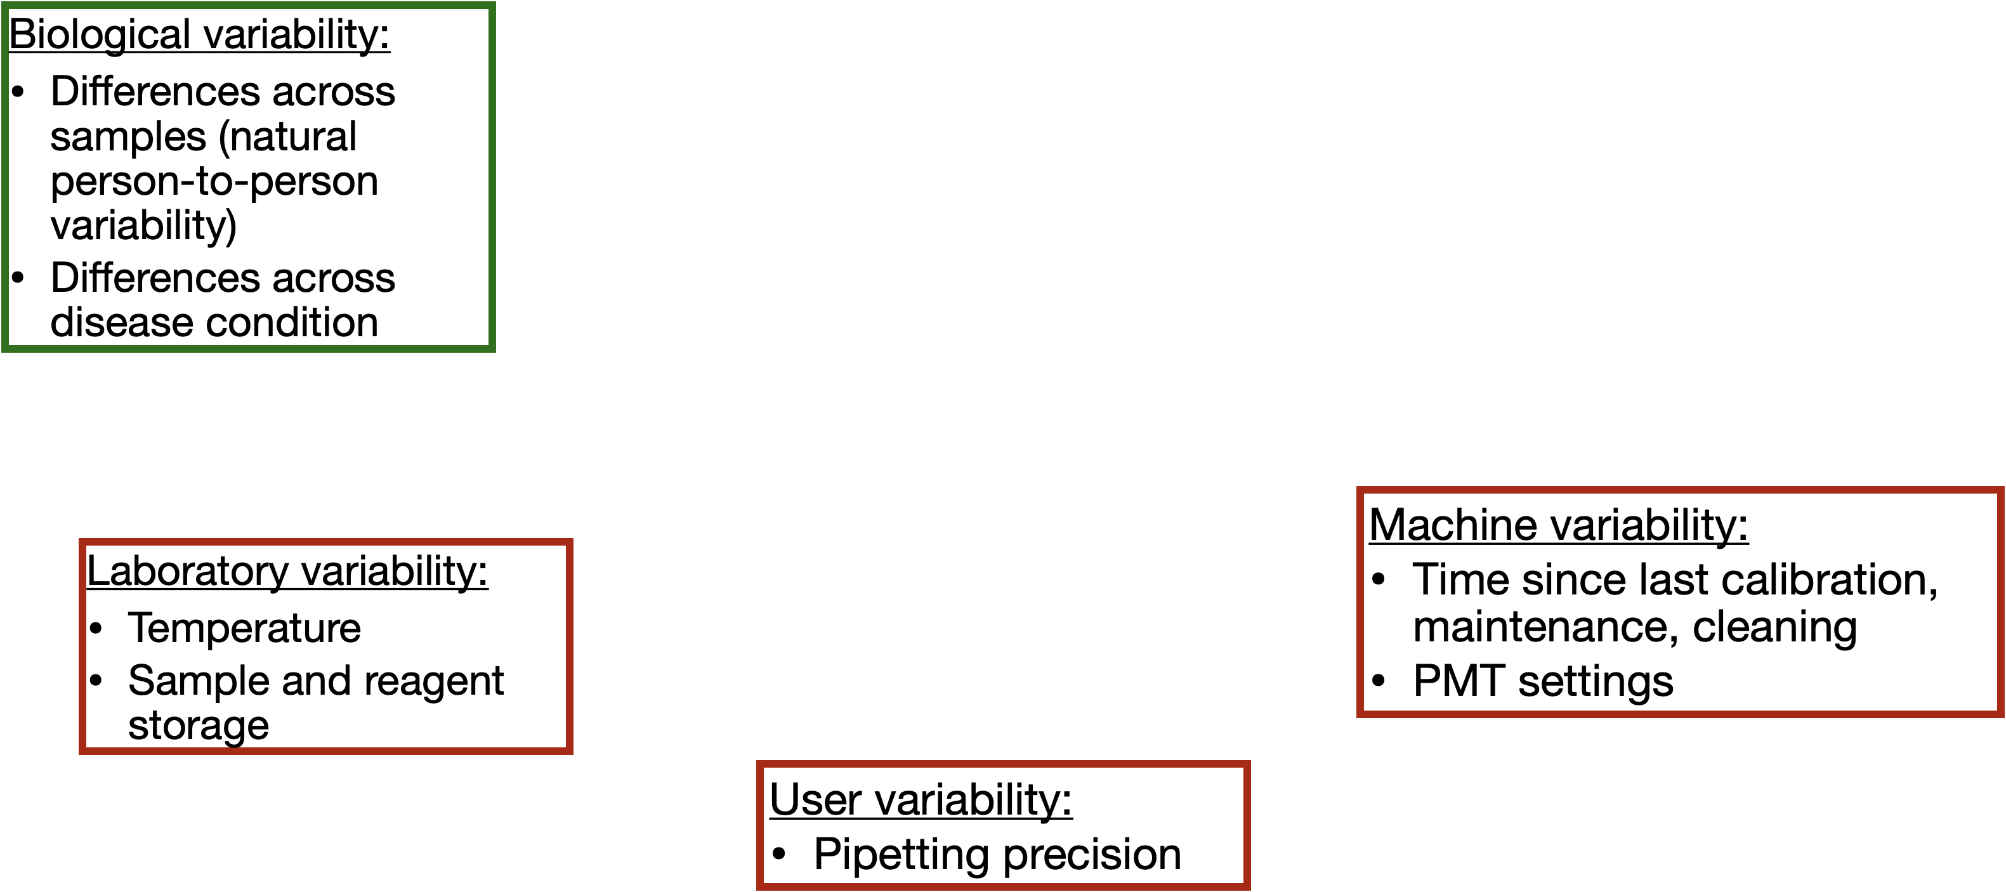
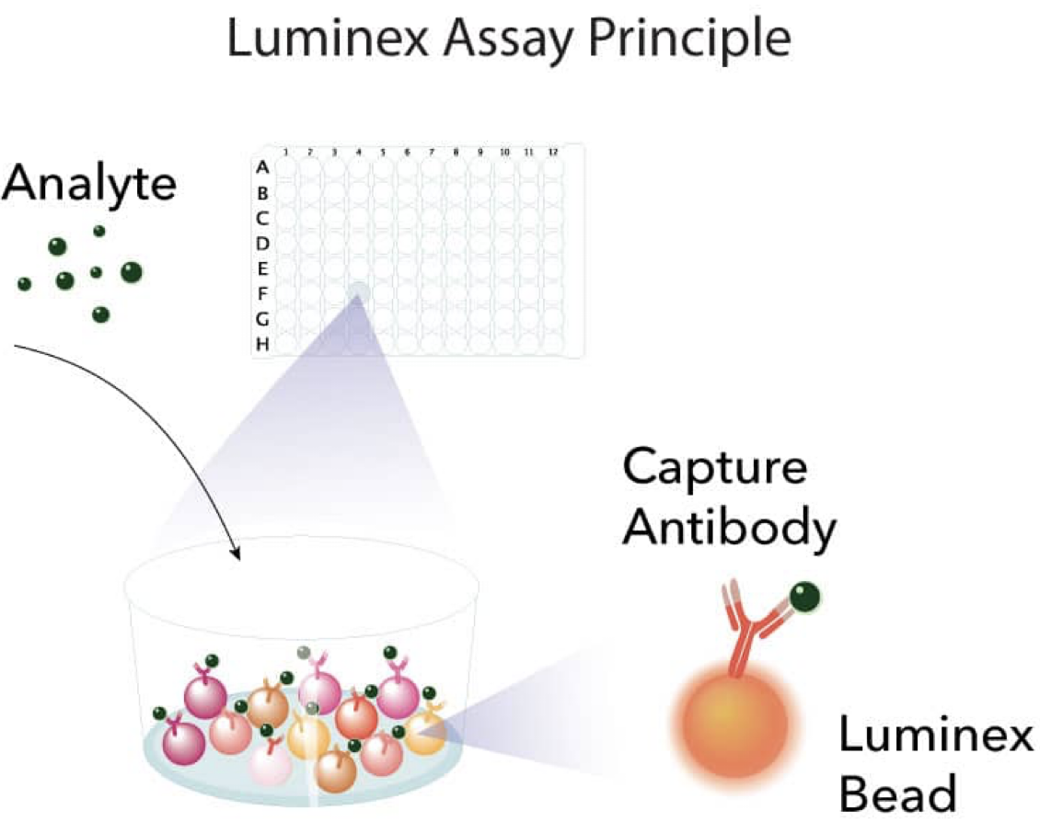
Raw MFIs contain biological and technical variation

Slide 5
Why is pre-processing important?
Pre-processing helps to adjust for sources of technical variation so that we can observe the true biological variation

Slide 6
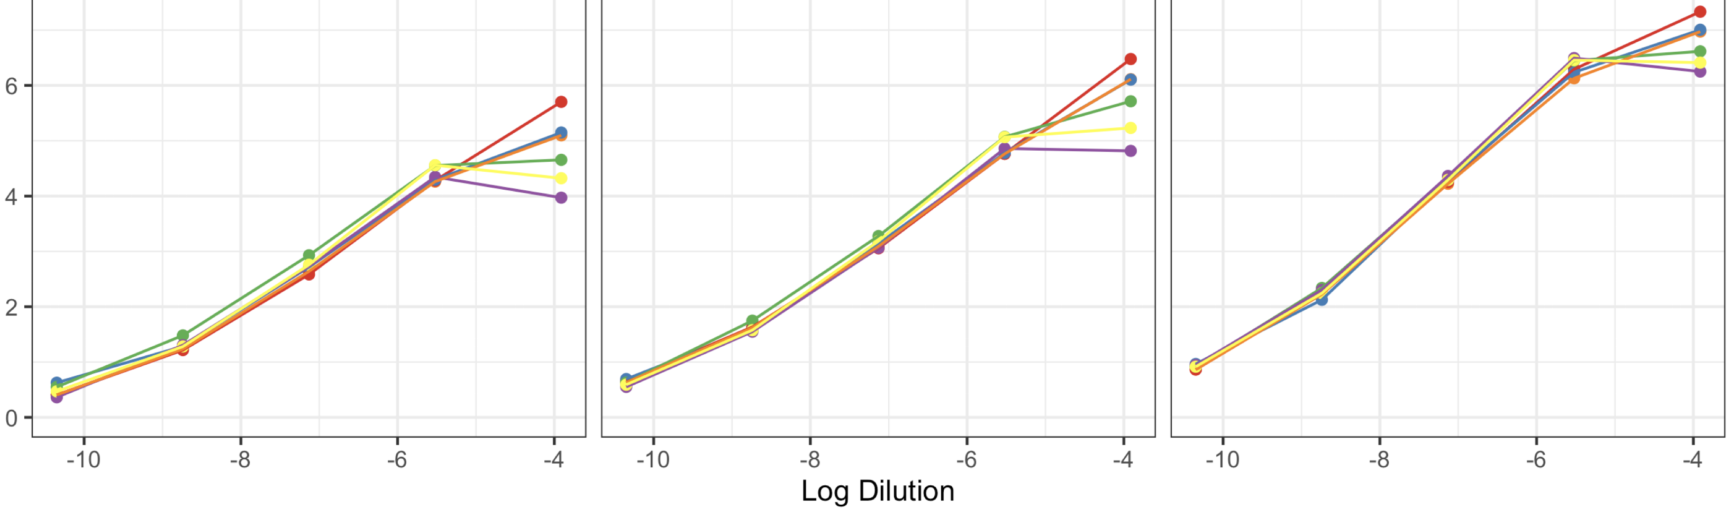
Raw MFIs contain biological and technical variation
Compare the same measurement (same sample, same antigen) across plates.

Slide 7
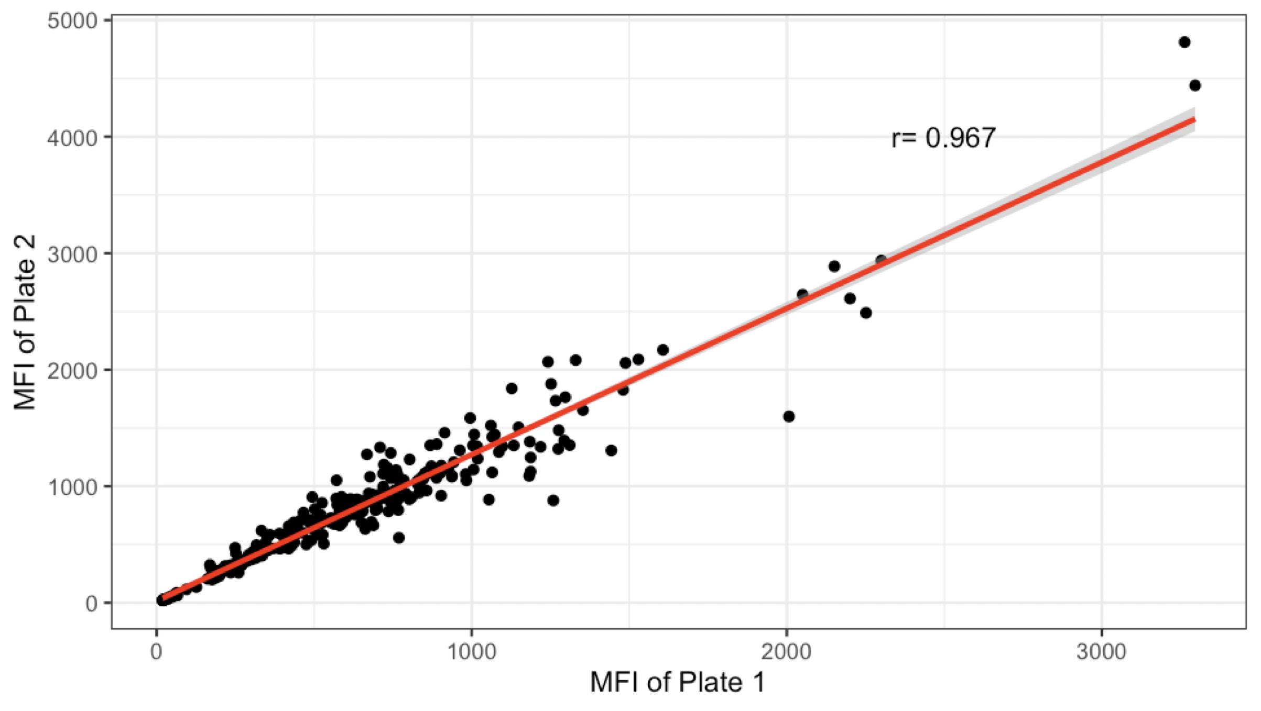
Running same samples on two plates
Notes:
Seems like similar values based on r

Slide 8
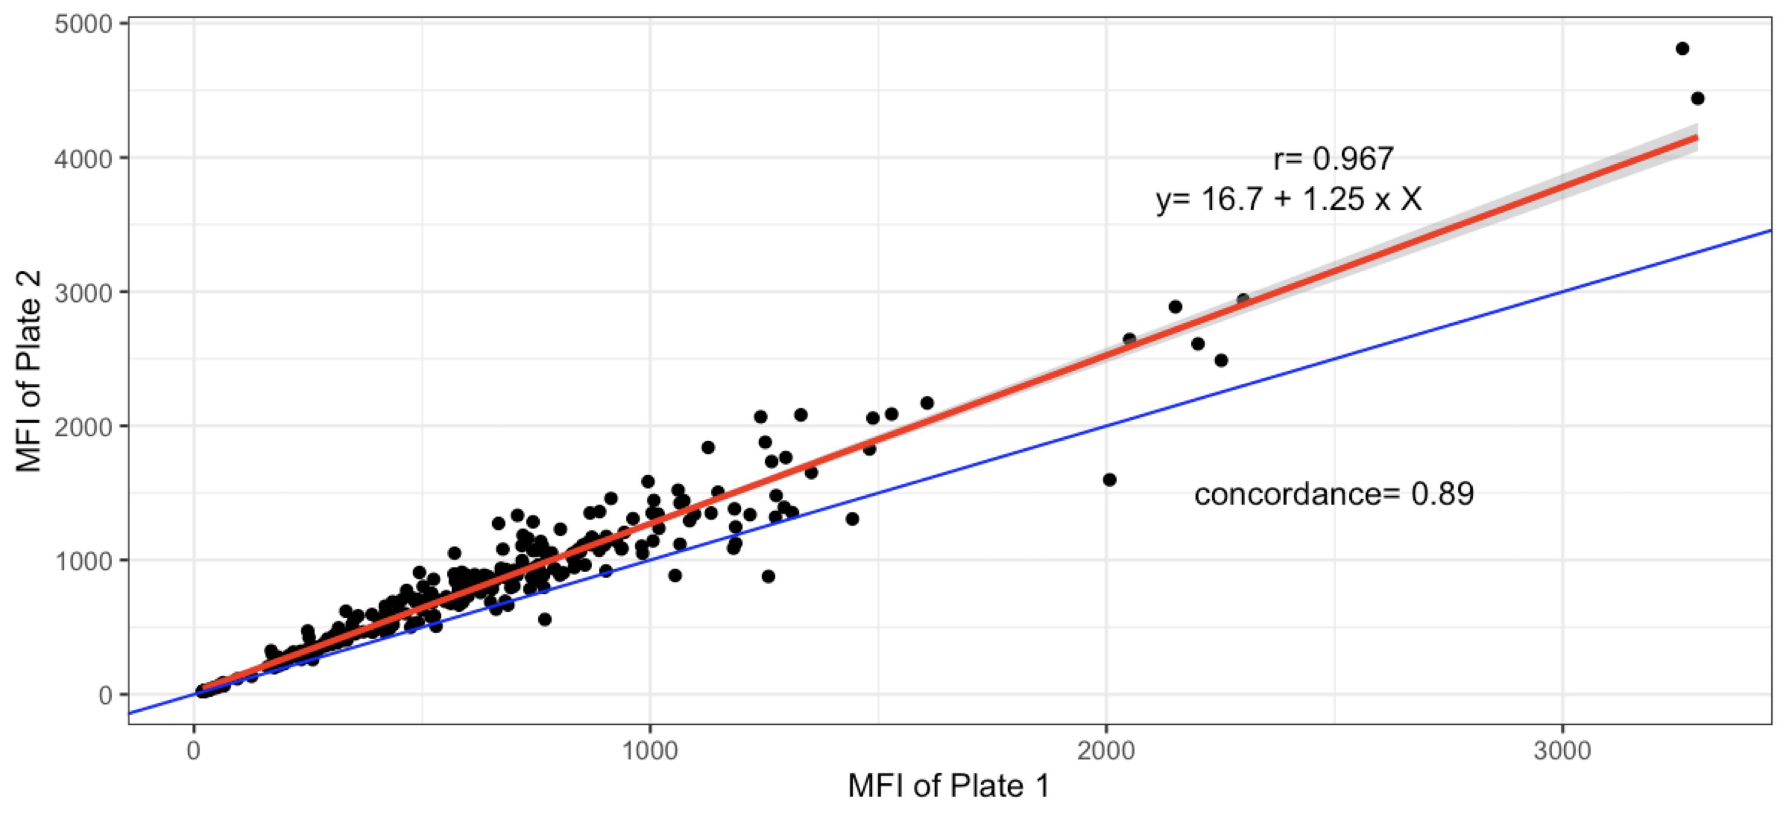
Running same samples on two plates
Must use concordance to evaluate whether values differ between plates, because distribution of values on plate 1 should be same as distribution of values on plate 2
- concordance is lower than r value
Notes:
how

Slide 9
When is pre-processing sufficient?
Compare methods that result in high concordance between plates for the same samples
Ideally, you will have samples that are run on every plate (like standards or controls)
If samples are randomly split between plates, then distribution between plates should be similar

Slide 10
Background correction
What is the background signal in assays?
Potential sources of background could be: plate effects, nonspecific binding, bead autofluorescence

Slide 11
Background correction
Techniques to correct for background signals:
• Blank subtraction: MFI_sample - MFI_blank
• Background division: MFI_sample / MFI_blank

Slide 12
Background correction
Example in R, walk through code showing adjusting for background with subtraction or division, and show comparison of results

Slide 13
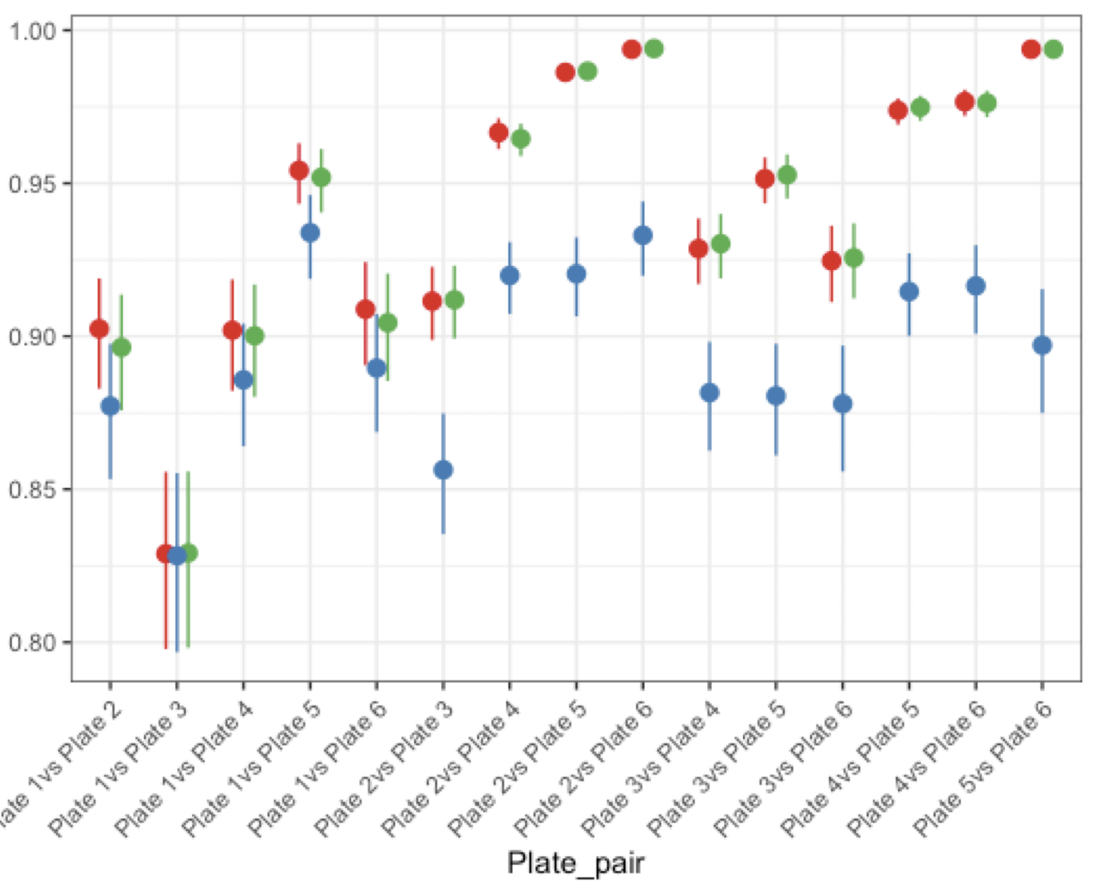
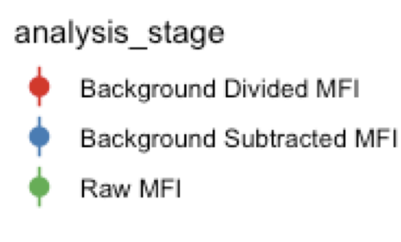
Example results of background correction
MBA for malaria study (6 x 384 well plates, 19 P. falciparum antigens)

Slide 14
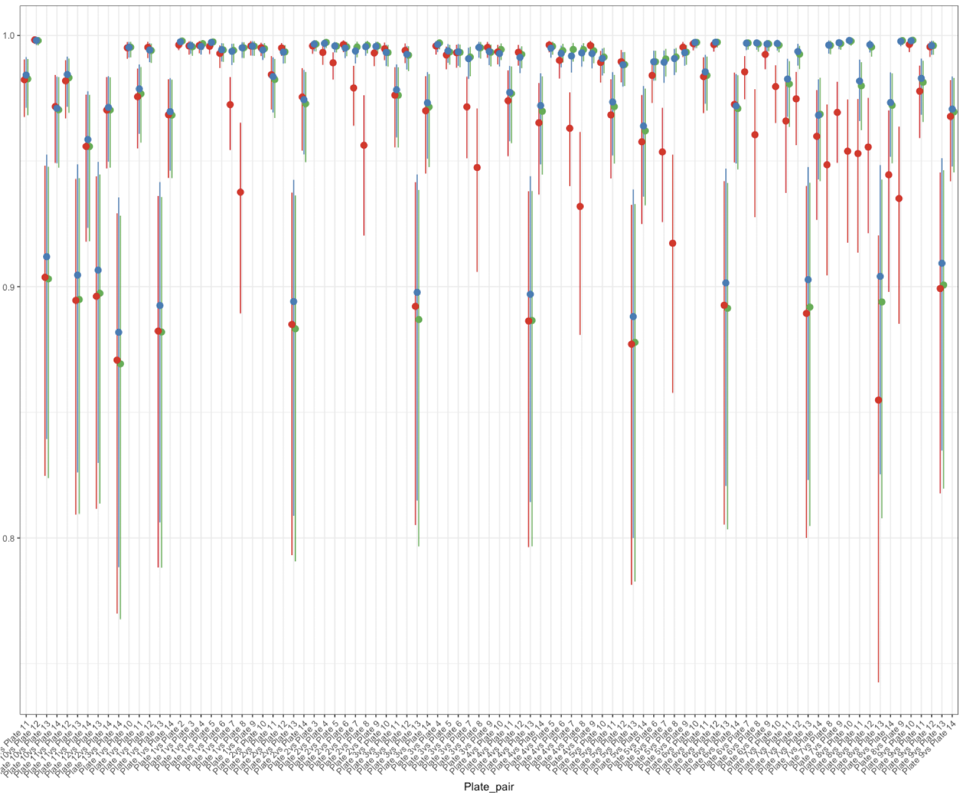
Optimal method for background correction may depend on the assay
MBA for malaria study (6 x 384 well plates, 19 P. falciparum antigens)
MBA for malaria study (14 x 96 well plates, 3 SARS-CoV2 antigens)

Slide 15
Remove low bead counts
Filter out samples that have a low bead count (low quality data)
Set a threshold for minimum bead count (eg 30 or 50 beads / antigen/ well)
It is important to have raw data that includes bead count
Show head of data file with box around bead count variables

Slide 16
Remove low bead counts
Filter out samples that have a low bead count (low quality data)
Show R code to filter

Slide 17
Transformation
Depending on the distribution of your data, you may want to transform it (eg log transformation) so that it fits a normal distribution
Boxcox transform
Show histograms of data before and after log transformation

Slide 18
Transformation
R code to do transformation
Make histograms of data before and after log transformation

Slide 19
Normalization

Slide 20
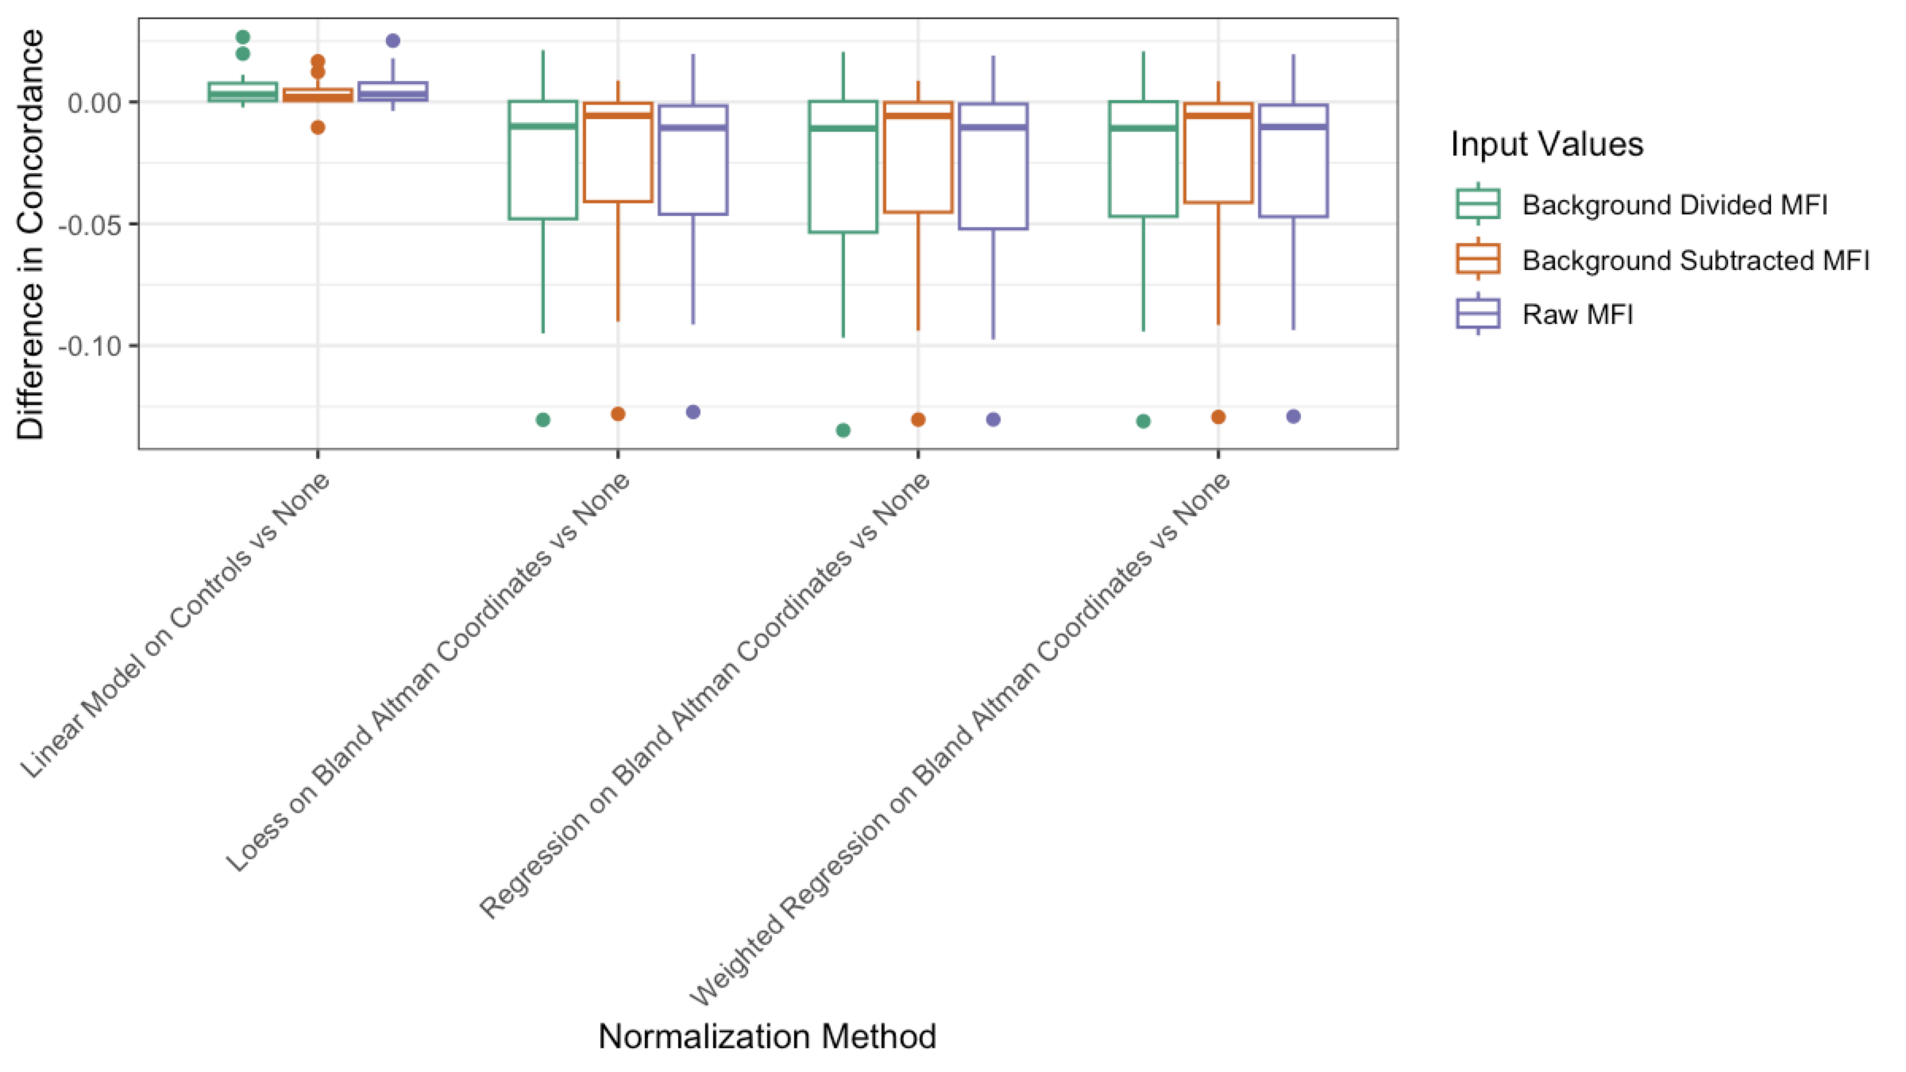
The right pre-processing minimizes technical variation

Slide 22
You can decide on a pipeline for pre-processing your data

